Slide 1
Software Architecture
Xiaobin Xu doublexb@163.com

Slide 2
Content
Symptoms of Poor Design (Design Smells)
SRP – The Single-Responsibility Principle
Software Systems Architecture
Xiaobin Xu

Slide 3
Symptoms of Poor Design (Design Smells)
Odors of rotting software:
Rigidity
Fragility
Immobility
Viscosity
Needless Complexity
Needless repetition
Opacity
Software Systems Architecture
Xiaobin Xu

Slide 4
Smells - Rigidity
The system is hard to change because every change forces many other changes to other parts of the system.
A design is rigid if a single change causes a cascade of subsequent changes in dependent modules.
The more modules that must be changed, the more rigid the design.
Root causes are bad modularization and
high coupling.
Software Systems Architecture
Xiaobin Xu

Slide 5
Coupling
Coupling describes how dependant one object is on another object (that it uses). Objects that are loosely coupled can be changed quite radically without impacting each other. The slightest change to objects that are tightly coupled can cause a host of problems.
Software Systems Architecture
Xiaobin Xu

Slide 6
Coupling
Problems with high coupling:
Change in one module forces changes in other modules
Modules are difficult to understand in isolation
Modules are difficult to reuse or test because dependent modules must be included.
The goal is Low Coupling
Software Systems Architecture Xiaobin Xu

Slide 7
Example
class A {
int x;
...
}
class B extends A { void b() {
x = 5;
}
}
Software Systems Architecture
Xiaobin Xu

Slide 8
Coupling
The emphasis on classes and inheritance can result in some types of undesirable coupling.
Erich Gamma (GoF): “Favor object composition over class inheritance. ”
Erich Gamma (GoF): “Program to an interface, not an implementation”
Software Systems Architecture
Xiaobin Xu

Slide 9
Smells - Fragility
Changes cause the system to break in places that have no conceptual relationship to the part that was changed.
Is closely related to rigidity (same root causes)
Managers (and now also developers) will fear change
Fragility tends to get worse, and the
software gets impossible to maintain
Software Systems Architecture
Xiaobin Xu

Slide 10
Smells - Immobility
It is hard to disentangle the system into components that can be reused in other systems.
May happen because modules are not designed for reuse, e.g. when modules depends on infrastructure or when modules are too specialized.
related to low cohesion
The consequence is that software is rewritten instead of reused.
Software Systems Architecture
Xiaobin Xu

Slide 11
Smells - Viscosity
Doing things right is harder than doing things wrong.
Two forms: Viscosity of the design or
viscosity of the environment.
If making changes that preserves the design is harder to do then doing “hacks”, the viscosity of the design is high.
Viscosity of environment comes about when the development environment is slow and inefficient.
Software Systems Architecture Xiaobin Xu

Slide 12
Smells – Needless Complexity
The design contains infrastructure that
adds no direct benefit.
This frequently happen when developers anticipate changes to the requirements, and put in facilities for those potential changes.
The design will carry the weight of all the unused design elements, and possibly make other changes difficult.
Software Systems Architecture
Xiaobin Xu

Slide 13
Smells – Needless repetition
The design contains repeating structures that could be unified under a single abstraction.
A result of cut and paste
All duplication is bad!
Be aware of semi-duplication, code that is almost the same. Is even worse to fix.
Makes the software difficult to maintain
Software Systems Architecture
Xiaobin Xu

Slide 14
Smells - Opacity
The code is hard to read and understand. It does not express its intent well.
Not following a coding standard
Bad or inconsistent naming
Bad or lacking commenting
Modules too big
Some kind of code review should be done to
avoid opaque code.
Software Systems Architecture
Xiaobin Xu

Slide 15
What Stimulates the Software to Rot?
Requirements always change!
Poor design!
Short-term-thinking!
Software Systems Architecture
Xiaobin Xu

Slide 16
Design Principles
Software design principles represent a set of guidelines that helps us to avoid having a bad design.
the principles of OO design:
SRP - Single Responsibility Principle
OCP - Open-Closed Principle
LSP - Liskov Substitution Principle
ISP - Interface-Segregation Principle
DIP - Dependency-Inversion Principle
Software Systems Architecture
Xiaobin Xu

Slide 17
SRP - Single Responsibility Principle
Principle: A class should have only one
reason to change.
Responsibility = ”a reason to change”
If a class has more than one responsibility, then the responsibilities become coupled.
The cohesion is low if the module does several things
Cohesion should be high
Software Systems Architecture
Xiaobin Xu

Slide 18
Cohesion
Cohesion: a measure of how well the lines of source code within a module work together to provide a specific piece of functionality. In object-oriented programming, the degree to which a method implements a single function. Methods that implement a single function are described as having high cohesion.
Software Systems Architecture
Xiaobin Xu

Slide 19
Cohesion
Cohesion is decreased if:
The responsibilities (methods) of a class have little in common.
Methods carry out many varied activities,
often using unrelated sets of data.
Software Systems Architecture
Xiaobin Xu

Slide 20
Cohesion
Disadvantages of low cohesion (or "weak
cohesion") are:
Increased difficulty in understanding modules.
Increased difficulty in maintaining a system.
Increased difficulty in reusing a module because most applications won’t need the random set of operations provided by a module.
Software Systems Architecture
Xiaobin Xu

Slide 21
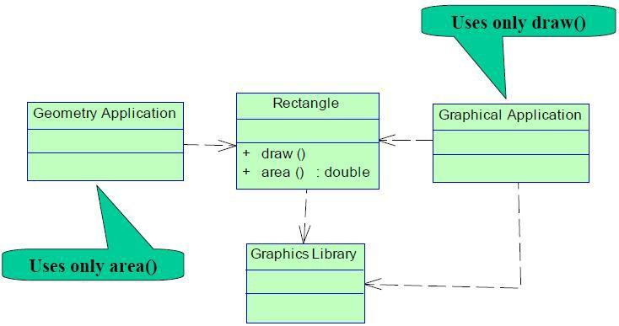
SRP Example I
Rectangle – Class with two responsibilities
Geometrical calculations
Drawing an object
Software Systems Architecture
Xiaobin Xu

Slide 22
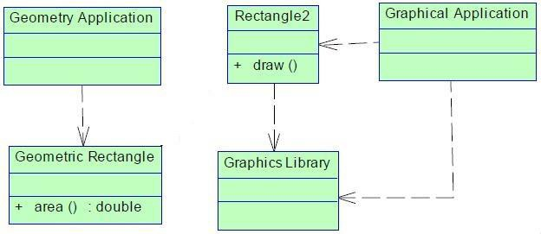
SRP Example I: better design
Separate the responsibility into 2 classes
Geometric Rectangle – Geometrical calculations
Rectangle2 – Drawing an object
Software Systems Architecture
Xiaobin Xu

Slide 23
SRP Example II
interface Modem
{
public void dial(String pno); public void handup(); public void send(char c); public char recv();
}
Software Systems Architecture
Xiaobin Xu

Slide 24
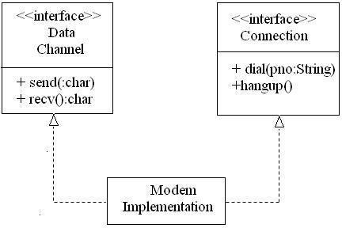
SRP Example II
Software Systems Architecture
Xiaobin Xu

Slide 25
SRP - Summary
But: Don’t separate responsibilities if it is unlikely to have independent changes. Otherwise, the codes will smell of “Needless Complexity”.
Software Systems Architecture
Xiaobin Xu

Slide 26
A broader perspective ...
The principle of high cohesion can be applied at different levels. The examples we have seen so far focus primarily on class-cohesion.
We can also talk about cohesion in methods, packages and subsystems.
Just as an example of method-cohesion, see: http://www.javaworld.com/jw-05- 1998/jw-05-techniques.html
Software Systems Architecture
Xiaobin Xu

Slide 27
Question
Please give an example that violates SRP and explain why? How to modify it to conform to SRP?
Software Systems Architecture
Xiaobin Xu

